Slide 1





LOGO
UNIV/POLTEK
DIGITAL TALENT SCHOLARSHIP
2019
digitalent.kominfo.go.id

Slide 2
Sesi 26b praktikum statistic deskriptive
Big Data Analytics

Slide 3
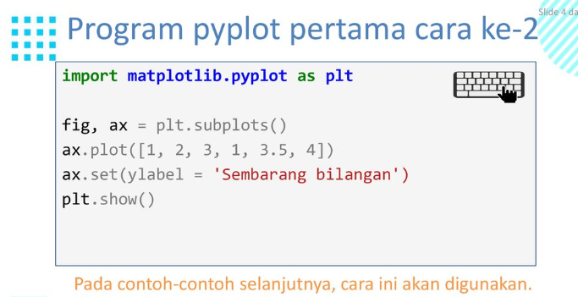

Slide 4
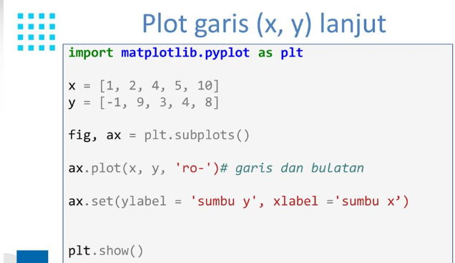

Slide 5
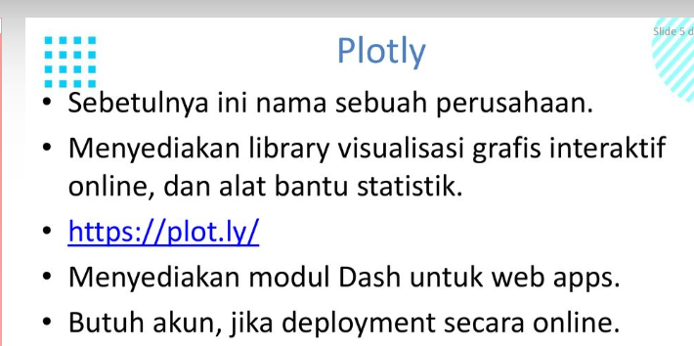

Slide 6
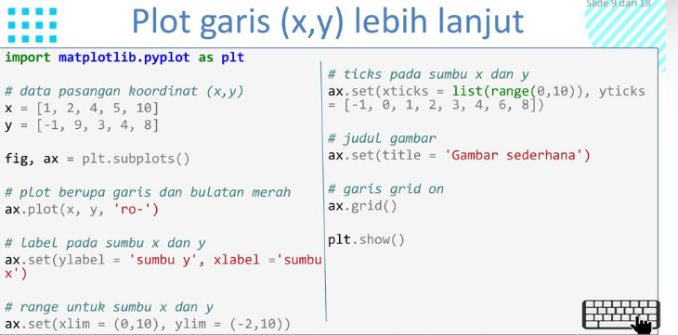

Slide 7
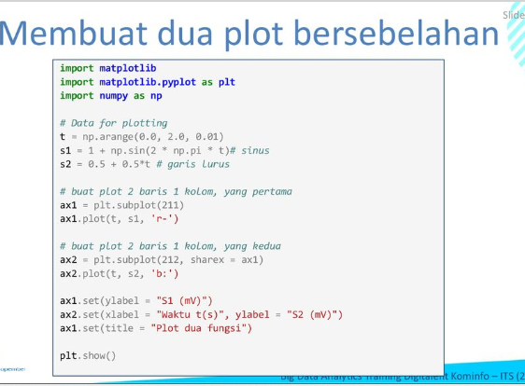

Slide 8
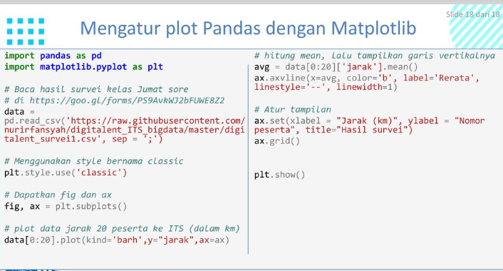

Slide 9
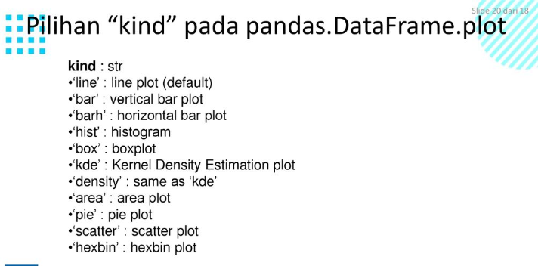

Slide 10
import pandas as pd
namaFilefo = "E:\\01 kerjaan tertunda\\materi dts\\football.csv"
data = pd.read_csv(namaFilefo)
data.head()

Slide 11
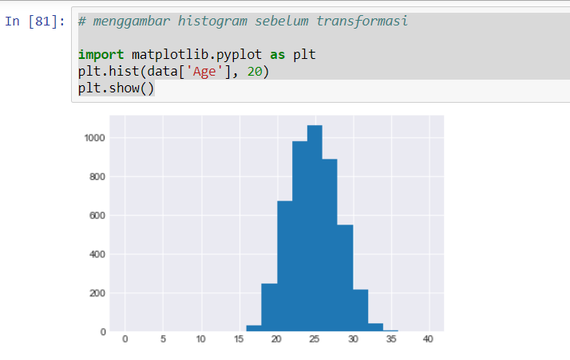

Slide 12
Menggambar diagram batang
#5. menampilkann diagram batang
import matplotlib.pyplot as plot
import numpy as np
subjects = ['Maths', 'Physics', 'Chemistry', 'French', 'Computers', 'English']
marks = [94,85,66,55,89,64]
m = np.arange(len(subjects))
plot.bar(m, marks)
plot.xlabel('Subject')
plot.ylabel('Marks')
plot.xticks(m, subjects)
plot.title('Marksained out of 100')
plot.show()
plot.bar(m, marks,color='indigo')
plot.xlabel('Subject',fontsize=15, fontweight='bold', color='blue')
plot.ylabel('Marks',fontsize=15, fontweight='bold', color='blue')
plot.xticks(m, subjects, fontsize=10, fontweight='bold', rotation=35, color='blue')
plot.title('Marksained out of 100',fontsize=15, fontweight='bold', color='blue')

Slide 13
def autolabel(rects):
"""Attach a text label above each bar in *rects*, displaying its height."""
for rect in rects:
height = rect.get_height()
ax.annotate('{}'.format(height),
xy=(rect.get_x() + rect.get_width() / 2, height),
xytext=(0, 3), # 3 points vertical offset
textcoords="offset points",
ha='center', va='bottom')
autolabel(rects1)
autolabel(rects2)
fig.tight_layout()
plt.show()
import matplotlib
import matplotlib.pyplot as plt
import numpy as np
labels = ['G1', 'G2', 'G3', 'G4', 'G5']
men_means = [20, 34, 30, 35, 27]
women_means = [25, 32, 34, 20, 25]
x = np.arange(len(labels)) # the label locations
width = 0.35 # the width of the bars
fig, ax = plt.subplots()
rects1 = ax.bar(x - width/2, men_means, width, label='Men')
rects2 = ax.bar(x + width/2, women_means, width, label='Women')
# Add some text for labels, title and custom x-axis tick labels, etc.
ax.set_ylabel('Scores')
ax.set_title('Scores by group and gender')
ax.set_xticks(x)
ax.set_xticklabels(labels)
ax.legend()

Slide 14
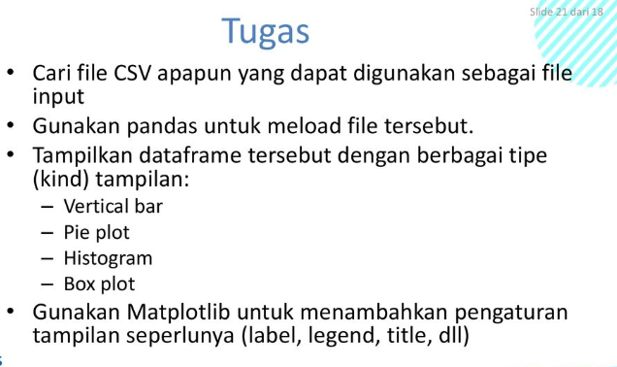

Slide 16
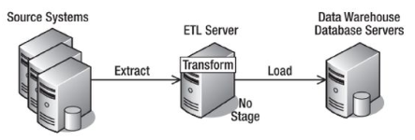
Load (1)
Langkah terakhir dari system ETL adalah Load yang berupa:
Penyimpanan data ke data warehouse
Menampilkan data ke aplikasi atau pengguna akhir.
Arsitektur ETL secara keseluruhan hingga tahap load adalah sebagai berikut:

Slide 17
Pertanyaan?

Slide 18





IKUTI KAMI
digitalent.kominfo
digitalent.kominfo
DTS_kominfo
Digital Talent Scholarship 2019
Pusat Pengembangan Profesi dan Sertifikasi
Badan Penelitian dan Pengembangan SDM
Kementerian Komunikasi dan Informatika
Jl. Medan Merdeka Barat No. 9
(Gd. Belakang Lt. 4 - 5)
Jakarta Pusat, 10110
digitalent.kominfo.go.id

